Slide 1
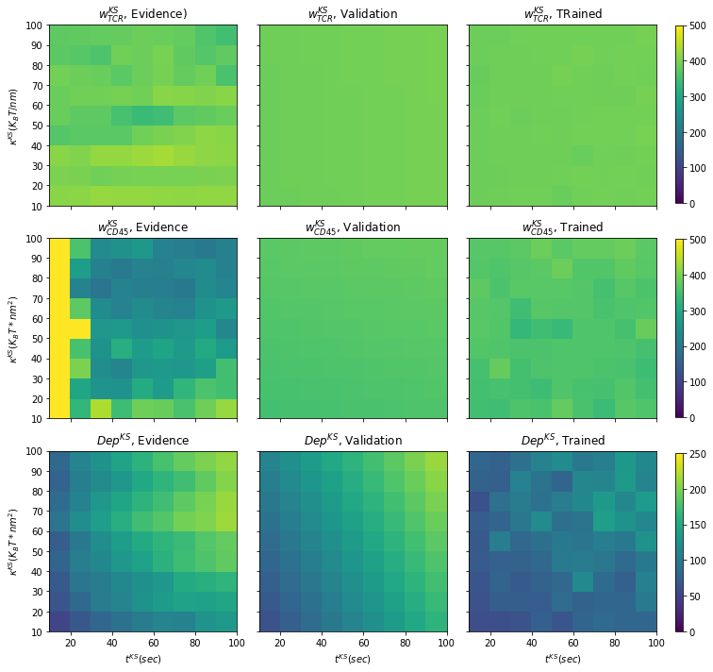
Fig. S3 - Model 1 – kinetic segregation (KS) – Evidence, validation, trained
A
B
C

Slide 2
Fig. S3 - Model 1 – kinetic segregation (KS) – Evidence, validation, trained
A
B
C
G
H
I
J
K
L

Slide 3
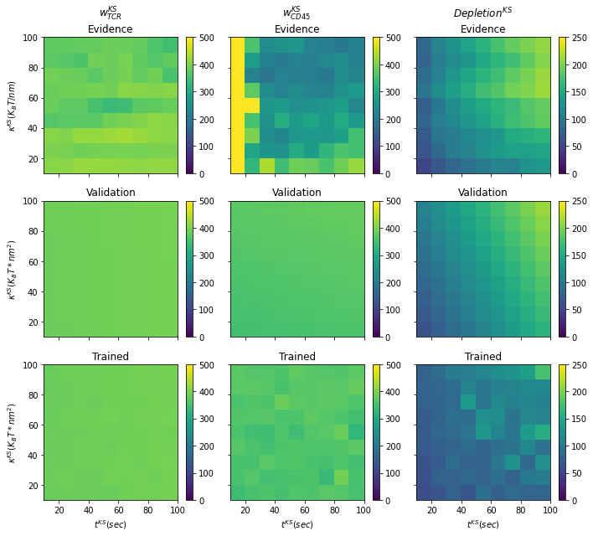
Fig. S3 - Model 1 – kinetic segregation (KS) – Evidence, validation, trained
A
B
C
G
H
I
J
K
L
Fig. S2A-C. Getting a single value that characterizes the cluster size of TCR (A), CD45 (B) and the depletion range between TCR and CD45 (C). Fig. S2D-F. Heatmaps that summarize the output data of model 1. D) full width of TCR distribution, E) full width of CD45 distribution, F) depletion distance between TCR and CD45. S2G-I. Heatmaps of the fitted model after running the PyMC3 package and checking the validation of the equations and random variables that we chose (sanity check).

